Slide 1


PACEdge Training Workshop Project-2 OPC UA Connext WebHMI MQTT Grafana

Slide 2
Example Description
Example Description:
PLC enables access to internal Tags via OPC UA server. Request is to visualize PLC data via WebHMI, via Grafana and Node-RED Dashboard. Example demonstrates internal data communication between Connext and Node-RED via MQTT and how Connext data can be stored in InfluxDB and visualized via Grafana
Design Approach:
PLC has OPC UA Server and exposes few tags
Within the PACEdge, Connext has OPC UA Client, which reads these tags
Data is visualized via WebHMI
Data is also published via MQTT
Node-RED gets data, stores it in InfluxDB, visualize it and enables user setpoint to be sent back to PLC

Slide 3
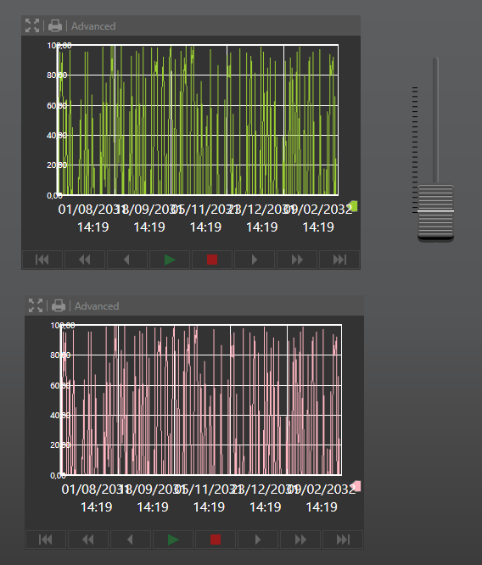
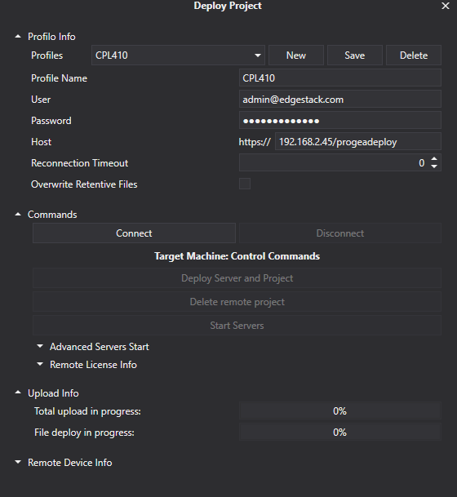
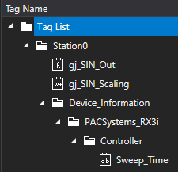
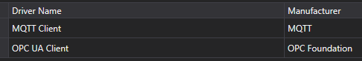
Connext and WebHMI
Port forward On CPL410
In PACEdge terminal execute the command:
ssh -g -L 4840:192.168.180.2:4840 admin@localhost
and connect with UA-Expert to port 4840 on PACEdge.
To cancel:
Press ~ + C (tilde + capital C), it is OK if tilde does not show up at first
Type -KL 4840 (or whatever port number)
Press Enter.
For BP, LP use Test OPC-UA Server:
192.168.5.200:55288
Two tags: gj_SIN_Out, gj_SIN_Scaling

Slide 4
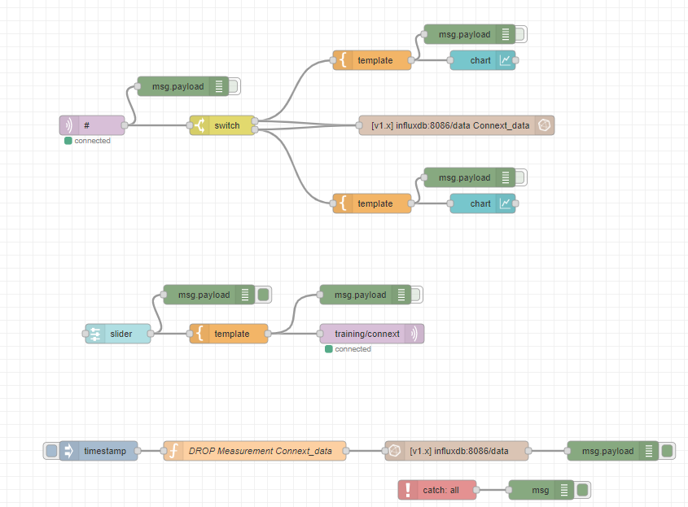
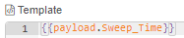
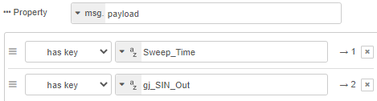
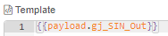
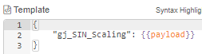
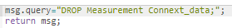
Node-RED Flow
Plain Text Ouput
Plain Text Ouput
Parsed JSON Ouput
10-100

Slide 5
Example Description
Example Description:
Changing example to use Node-RED OPC UA Client instead of Connext.
Design Approach:
PLC has OPC UA Server and exposes few tags
Within the PACEdge, Node-RED has the OPC UA Client, which reads these tags
Node-RED stores data in InfluxDB, visualize it and enables user setpoint to be sent back to PLC

Slide 6
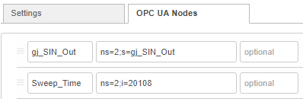
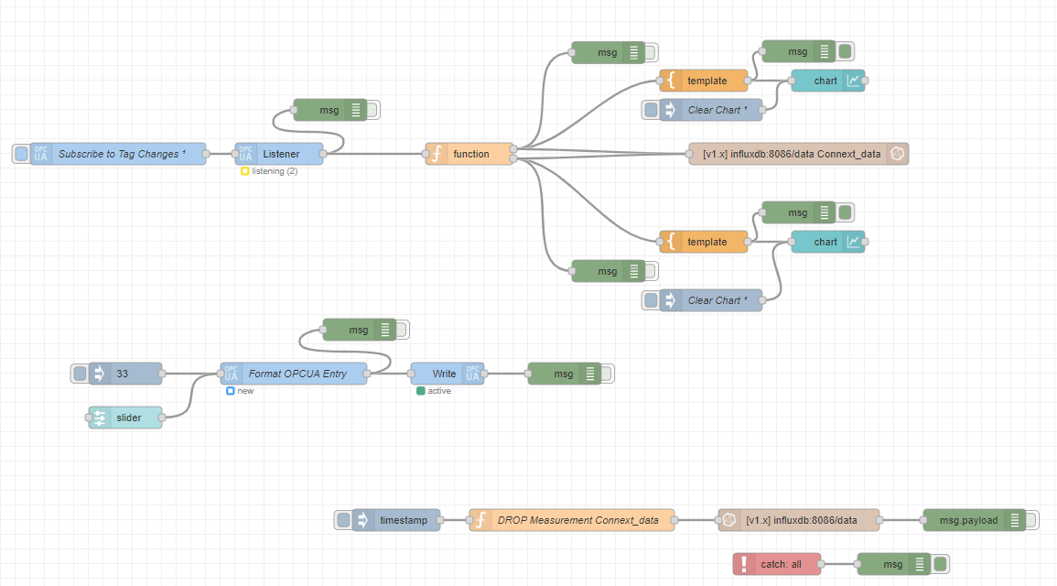
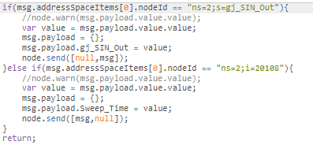
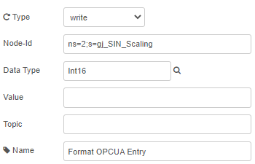
Node-RED Flow: Using Node-RED OPC UA Client

Slide 7
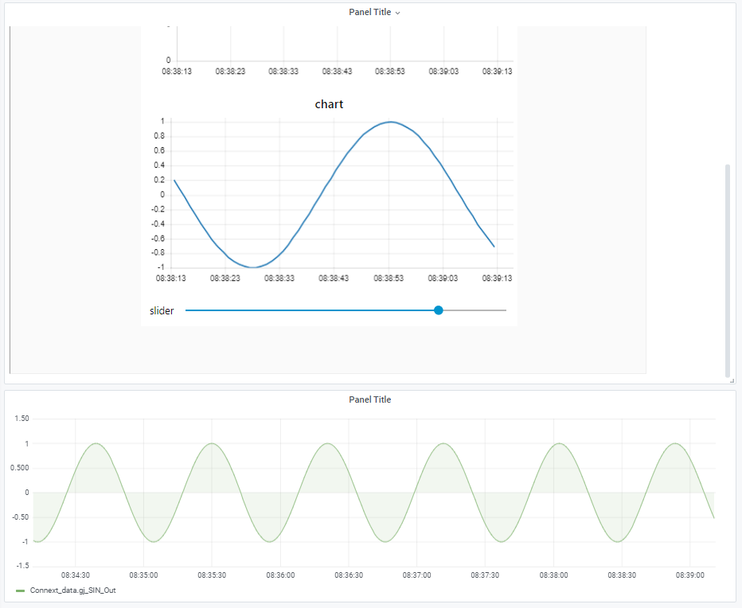
Grafana with Node-RED Dashboard Controls Embedded
disable_sanitize_html = true
Create new Panel, choose Text, enable HTML and paste in following address: <iframe src="/nodered/ui" width= "1000" height="900"></iframe>

